Slide 1

Northeastern University - Seattle
CS6650 Building Scalable Distributed Systems
Vishal Rajpal

Slide 2
Week 5 – Scalable Service Design
Topics we will cover today:
Service API Design
Servlets
Application Services Containers
Horizontal Scaling
Load Balancing

Slide 3
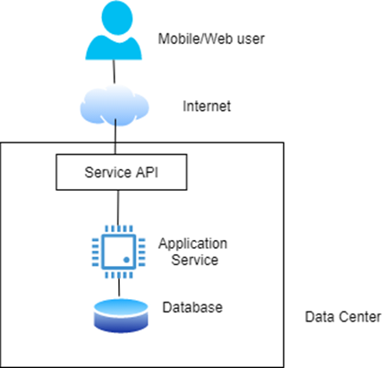
HTTP API Design
Notes:
For any system there are application requirements.
Those requirements are implemented as the applications business logic.
For a distributed system, the business logic is exposed to clients through a set of APIs.
And as with any distributed system the APIs are designed to support concurrent remote calls.
In this slide a simple example is shown where an internet facing service persists data to a local data store.
Clients interact with the service through its published APIs which are accessible across the internet.

Slide 4
Service API Design
An API defines a contract between the client and server.
Dominant contemporary style is HTTP APIs.
CRUD Pattern - Create, Read, Update, Delete.
An aside - REST is an architectural style that was defined by Roy Fielding in his PhD thesis
Notes:
An API defines a contract between the client and server.
It specifies the types of requests that are possible, the data that is needed to accompany the requests and the results that can be obtained.
There are different styles an API can be written as we talked about RPC/RMI last week but HTTP style APIs are dominant.
CRUD pattern.
Generally HTTP APIs are classified as RESTful.
REST is an architectural API design approach.

Slide 5
Service API Design
CRUD HTTP APIs
Verb | Uniform Resource Identifier Example | Purpose
POST | /skico.com/skiers/ | Create a new skier profile with skier details provided in the JSON request payload. The newly created skier profile is returned in the JSON response payload.
GET | /skico.com/skiers/(skierID) | Get the profile information for a skier, returned in a JSON response payload
PUT | /skico.com/skiers/{skierID} | Update skier profile
DELETE | /skico.com/skiers/{skierID} | Delete a skier’s profile as they didn’t renew their pass!
Notes:
A CRUD API specifies how API clients perform operations in a specific business context.
Example CRUD APIs for ski resort system.

Slide 6
Service API Design
CRUD HTTP APIs
A HTTP CRUD API applies HTTP verbs on resources identified by Uniform Resource Identifiers (URIs)
/skico.com/skiers/768934
Combination of HTTP verb and URI define the semantics of the API operation.
Payloads formatted as JSON
XML or text also possible.
Resources, represented by URIs, are conceptually like objects in Object Oriented Design (OOD) or entities in Entity-Relationship (ER) model.
Notes:
A HTTP CRUD API applies HTTP verbs on resources identified by a Uniform Resource Identifier (URI).
In this example, a URI that identifies Skier 768934 is shown here.
The combination on this URL and the HTTP verb define the semantics of the API operation.
Resources represented by URIs are represented typically as Objects/Instances in a Object oriented language.

Slide 7
Service API Design
API Specification – OpenAPI
Notes:
HTTP APIs can be specified using OpenAPI notation. 3.0 being its latest version.
A tool called SwaggerHub is the de facto standard to specify APIs in OpenAPI.
The tool helps design, build, document and consume REST APIs.
The OpenAPI specification is defined in a markup language known as YAML.
The example specifies the GET operation on the URI resorts.

Slide 8
Designing Services
Application server receives requests and routes them to the appropriate handler function.
Handler is defined by the application and implements the business logic
Each request is (typically) allocated a thread to execute the request
Example Express.js server
app.get('/skiers/:skierID', function (req, res) {
// process the GET request
ProcessRequest(req.params)
}
Notes:
An application server receives the requests and routes them to an appropriate handler function to process the request.
The handler is defined by the application service code and implements the business logic required to generate results for that request.
As multiple requests arrive at a service instance, each request is typically allocated an individual thread to execute the request.
There are different ways technologies choose to route requests.
In Express.js the container calls the matching method to the API signature

Slide 9
Designing Services
Java – Spring Framework
1. @RestController
2. public class SkierController {
3.
4. @GetMapping("/skiers/{skierID}",
5. produces = “application/json”)
6. public Profile GetSkierProfile(
7. @PathVariable String skierID,
8. ) {
9. // DB query method omitted for brevity
10. return GetProfileFromDB(skierID);
11. }
12. }
Notes:
In Java. Spring framework provides another routing technique.
There are annotations defined to route requests.
These annotations define dependencies and implement dependency injection to simplify the service code.
@RestController identifies classes that implement APIs and automatically serializes the return objects into HTTP response.
@GetMapping maps the API to a specific method and defines format of the response body.
@PathVariable a parameter that originates from the URI.

Slide 10
Java Servlets
@WebServlet annotation identifies the base pattern for the URI which causes a servlet to be invoked.
Servlet must extend the HttpServlet abstract class and override at least one method that implements a HTTP request.
doGet: HTTP GET requests
doPost: HTTP POST requests
doPut: HTTP PUT requests
doDelete: for HTTP DELETE requests
Notes:
Another Java technology, Java Enterprise Edition also provides annotations but are simpler as compared to Spring.

Slide 11
Java Servlets
import javax.servlet.http.*;
@WebServlet(
name = “SkiersServlet“,
urlPatterns = “/skiers”
)
public class SkierServlet extends HttpServlet (
protected void doGet(HttpServletRequest request, HttpServletResponse response) {
// handles requests to /skiers/{skierID}
try {
// extract skierID from the request URI (not shown for brevity)
String skierID = getSkierIDFromRequest(request);
if(skierID == null) {
// request was poorly formatted, return error code
response.setStatus(HttpServletResponse.SC_BAD_REQUEST); }
else {
// read the skier profile from the database
Profile profile = GetSkierProfile (skierID);
// add skier profile as JSON to HTTP response and return 200
response.setContentType("application/json");
response.getWriter().write(gson.toJson(Profile);
response.setStatus(HttpServletResponse.SC_OK);
} catch(Exception ex) {
response.setStatus(HttpServletResponse.SC_INTERNAL_SERVER_ERROR);
}}}}
Notes:
Servlets therefore require code but are more efficient.

Slide 12
State Management
Conversational State
Service implementations that need to scale should avoid storing conversational state.
any information that is retained between requests such that the subsequent request can assume the service has retained state about the interactions
GET /skico.com/skiers/768934
PUT /skico.com/skiers/phoneno/4123131169
When the service receives the initial GET request:
creates a session state object that uniquely identifies the client connection.
session state object stores conversational state – in our example this would be skierID.
When PUT request arrives it uses the session state object to look up the skierID
Services that maintain conversational state are known as stateful services.
JEE servlets support the HttpSession object,
Session object in ASP.NET.
Notes:
When a client connects to a server, it will typically send a series of requests to retrieve and update information.
Conversational state represents any information that is retained between requests such that a subsequent request can assume that the service has retained knowledge about the previous interactions.
In the above example, after client sends a GET request, the client sends a subsequent PUT request which does not specify the skier id assuming that the server has stored that state.

Slide 13
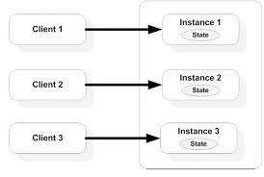
Stateful Services
Problems with state management:
session state uses available server memory
how long to keep session state available?
Notes:
For services with low traffic, stateful services make eminent sense and are promoted by many frameworks to make services east to build and deploy.
As an example, JEE servlets support session management using HttpSession Object and similar capabilities are offered by the Session object in ASP.NET.
At scale however, the stateful approach becomes problematic.
As an example, for a single service instance there are two problems to be considered.
If there are multiple client sessions and their state is being managed, this will utilize available service memory. The amount of memory utilized will be proportional to the number of clients the service is maintaining state for. If there is a sudden spike in the number of clients how can it be certain that all the memory will not be exhausted causing the service to fail?
There also needs to be some limit on how long to keep the session state available. A client may stop sending requests but not cleanly close their connection. All session management approaches support a default session timeout. If you set this to a short time interval clients may see their state disappear unexpectedly. If you set the timeout too long performance of the service may be degraded as it runs low on resources.

Slide 14
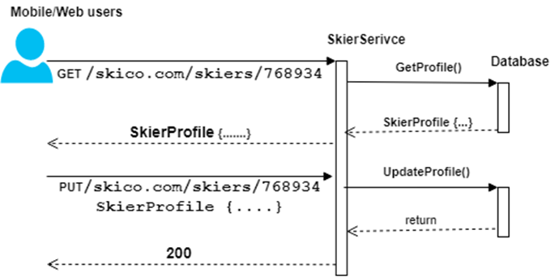
Stateless Services
Stateless services do not store conversational state
Each request is standalone and can be processed individually.
Requires client to provide all the necessary information for the server to process the request and provide a response.
PUT /skico.com/skiers/768934/phoneno/4123131169
Notes:
Stateless services do not assume any conversational state from previous calls so that each request can be processed individually.
This requires client to provide all the necessary information for the service to process the request and provide a response.
Talk about Availability vs Performance when the session state is persisted in a database.

Slide 15
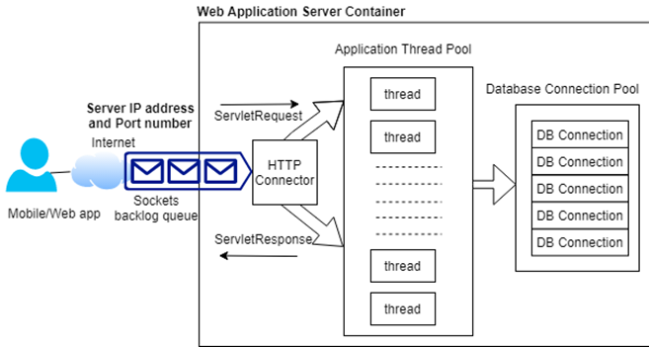
Application Servers
Heart of a scalable application
Host the business services that comprise an application.
Technological landscape of application servers is broad, e.g:
Java Enterprise Edition (JEE)
Express.js server supports Node
Flask supports Python
GoLang a server can be created by incorporating the net/http package.
Apache Tomcat server
Tomcat Example
Notes:
Applications servers are heart of a scalable application hosting the business services that compose an application. Their basic role is to accept requests from clients, apply application logic to the requests and reply to the client with the results.
There are various existing application servers depending on the language you want to use and capabilities each offers.
The picture shows a simplified view of a service using Tomcat server.
Tomcat implements a servlet container which is an execution environment for application defined servlets.
Servlets are dynamically loaded into this container, which provides the life cycle management and a multithreaded runtime environment.
A tomcat server on a particular IP address listens by default on 8080 (HTTP) and 8443 (HTTPS). If network requests arrive at a frequency that cannot be processed by the TCP listener, pending requests are queued up in the sockets backlog queue. In most Linux versions the default size is 100.
Once a connection is established with the server, all requests are marshalled by HTTP Connector which generates the HTTP request that the servlet code can process. The HTTP requests is then dispatched to an application container thread tp process.
Application container threads are managed in a thread pool which by default in Tomcat is a minimum size of 25 and a maximum of 200.
If the business logic needs to query an external database it requests a connection from the database connection pool. If there is one available access to the connection is granted until it indicates it has completed the work.

Slide 16
Application Servers
Apache Tomcat
Highly configurable to different handle different workloads.
Request latency governed by:
the request processing time in the servlet
the time spent waiting in queues for threads and DB connections
In a heavily loaded server
Context switching may start to degrade performance.
Available memory may be become limited.
Queues grow as requests wait for resources.
Eventually new TCP/IP connections will be refused,
Overloaded server will run out of resources and crash.
Notes:
An application server framework such as Tomcat is highly configurable for different workloads. For example, the size of the thread and database connection pools.
The complete container environment runs within a single JVM and hence processing capacity is limited by the number of vCPUs available and the amount of memory allocated as heap size.
Each allocated thread consumes memory and various queues in the request processing pipeline consume resources which requests are waiting.
This means the request response time is governed by both the request processing time in the servlet business logic and time spent waiting in queues for threads and connections to become available.
In a heavily loaded server with many threads allocated, context switching may start to degrade performance and available memory may become limited.
If performance degrades queues grow as requests wait for resources. This consumes more memory. If more requests are received that can be queued and procesed by the server, then the new TCP/IP connections will be refused and clients will experience errors.

Slide 17
Application Servers
Performance Tuning
Tuning configuration parameters is important
If CPU utilization consistently exceeds the 70-80% range = overload signal
Similar insights exist for memory usage
Once any resource gets close to full utilization, systems tend to exhibit less predictable performance
Notes:
Effort to tune configuration parameters to efficiently handle anticipated loads is rarely wasted.
Systems tend to degrade performance well before they reach 100% utilization.
Once any resource i.e. CPU utilization, memory usage, network, disk access etc. gets close to full utilization systems exhibit less predictable performance.
This is because more time is spent on time-wasting tasks such as context switching and memory garbage collection causing higher latencies and low throughput.
Hence, having thresholds for these parameters is important.

Slide 18
Application Servers
Monitoring Tools
Monitoring tools available for Web application frameworks,
Latencies
active requests
queue sizes
Java-based application frameworks support the JMX (Java Management Extensions) framework,
JMX exposes monitoring information based on the capabilities of MBeans (Managed Beans),
Eco-system of tools for monitoring JMX
JConsole
JavaMelody
Notes:
Java based application frameworks such as Tomcat support Java Management Extensions (JMX) framework.
It enables frameworks to expose monitoring information based on the capabilities of Managed Beans which represent a resource of interest such as thread pools, database connections usage etc.
This enables tools to offer capabilities to monitor JMX supported platforms.

Slide 19
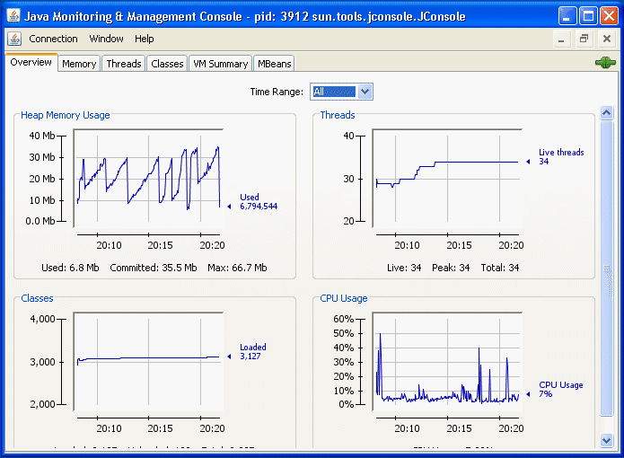
Application Servers
JConsole

Slide 20
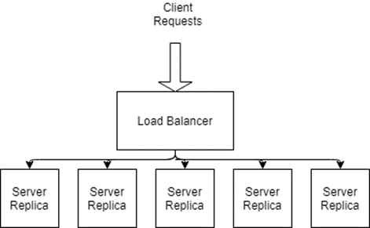
Horizontal Scaling
Service replicas are deployed on their own (virtual) hardware
The services need to be stateless
Any request sent to any service by load balancer
Horizontal scaling also increases availability.
eliminates single point of failure (SPoF)
If one replica fails, requests can be directed to any replica.
Notes:
A core principle of scaling a system is being able to easily add new processing capacity to handle increased load.
For most systems a simple and effective approach is deploying multiple instances of stateless server resources and using a load balancer to distribute requests across these instances
This is known as horizontal scaling.
The aim of horizontal scaling is to create a system processing capacity that is the sun of the total resources available.
The servers need to be stateless so that any request can be sent to any service replica.

Slide 21

Load Balancing
Aims to utilize capacity of a collection of services to optimize response time for each request.
Distributes requests across the available services as evenly as possible
Clients send requests to the load balancer
redirects requests to target services
relays the results back to the client.
Notes:
Load balancing aims to effectively utilize the capacity of a collection of replicas to optimize the response time for each request.
The objective is to avoid overloading some services while underutilizing others.

Slide 22
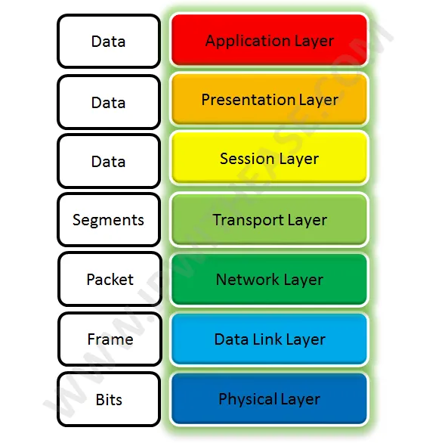
Load Balancers
Two types of load balancers
Network Level
Application Level
Called Layer 4 and Layer 7 load balancers respectively.
Notes:
Load balancers may act at the network layer or at the application level.
Often called layer 4 or layer 7 load balancer respectively.
Layer4 represents transport layer in Open Systems Interconnect (OSI)
OSI characterizes network communications into 7 abstract layers.
Each layer defines how the data is packaged and transported.

Slide 23
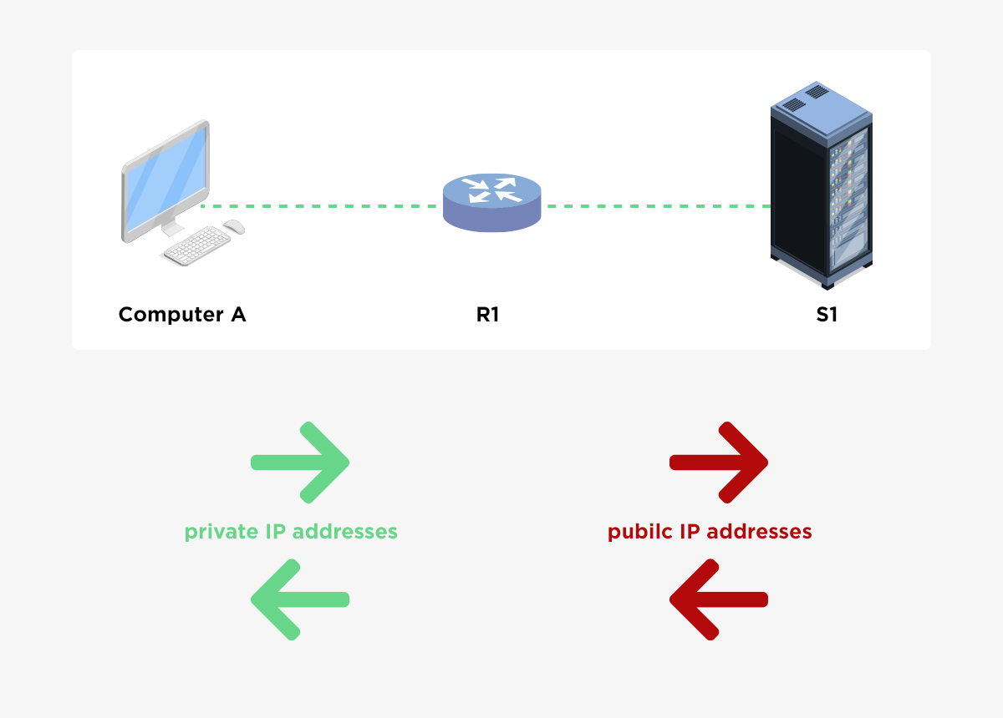
Load Balancers
Network Load Balancers
Distribute requests at the network connection level
Operates on individual TCP/UDP packets.
Routing decisions based on IP addresses.
Uses a technique called Network Address Translation (NAT).
Relatively simple and extremely fast
Notes:
Network-level load balancers distribute requests at the network connection level operating on individual TCP or UDP packets.
Routing decisions are made on the basis of client IP addresses.
Once a target service is chosen, the load balancer uses a technique known as Network Address Translation (NAT).
This changes the destination IP address in the client request packet to the IP address of the chosen target.
When a response is received from the the load balancer changes the source IP address recorded in the packet header from the target’s IP address to its own.
Since network load balancers operate on an individual packet they are extremely fast.

Slide 24
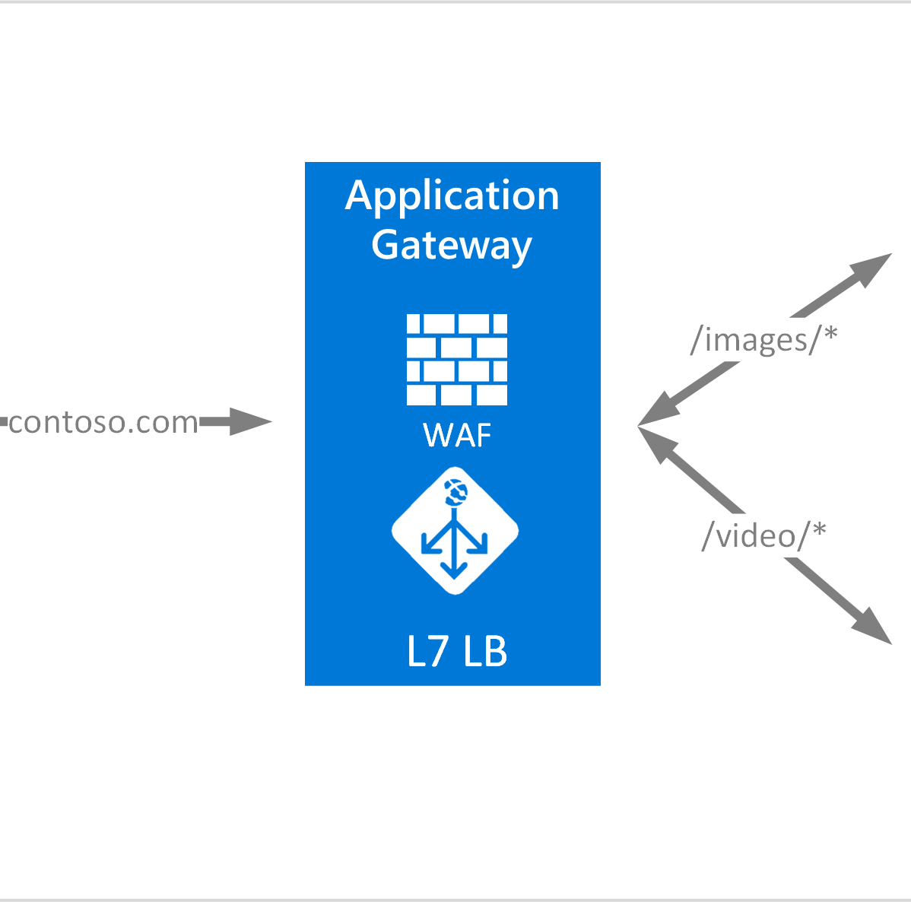
Load Balancers
Application Load Balancers
Routing decisions based on HTTP headers and on the contents of the message.
For example:
send all POST requests to a subset of available services
distribute requests based on a query string in the URI
Richer capabilities means they are slightly slower than network load balancers
Notes:
In contrast, application level load balancers reassemble the complete HTTP request and base their routing decisions on the values of the HTTP headers and on the actual components of the message.
For example, a load balancer can be configured to send all POST requests to a subset of available services or distribute requests based on a query string in the URI.
Application load balancers are sophisticated reverse proxies. The richer capabilities mean they are slightly slower than network load balancers but the powerful features they offer can be utilized to make up for the overheads incurred.

Slide 25
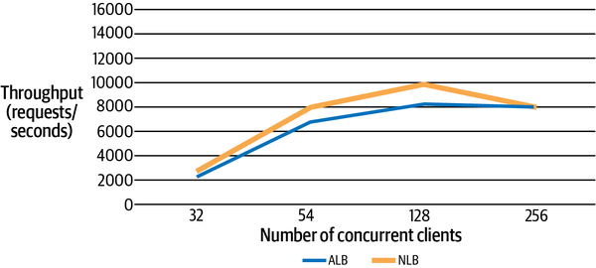
Load Balancers
Performance Comparison
Notes:
- You can see from that the network load balancer delivers on average around 20% higher performance for the 32, 64, and 128 client tests. This validates the expected higher performance from the less sophisticated network load balancer. For 256 clients, the performance of the two load balancers is essentially the same. This is because the capacity of the service replicas is exceeded and the system has a bottleneck. At this stage the load balancers make no difference to the system performance. You need to add more replicas to the load balancing group to increase system capacity, and hence throughput.

Slide 26
Load Balancers
Load Balancer Features
Load Distribution Policies
Many policies supported, e.g.
round-robin
least connections
HTTP header field
HTTP operation
Also support allocating server weights
Load distribution policies
Health monitoring
Elasticity
Session affinity
Notes:
In general a Load balancer has the following features. (picture on the right)
Load distribution policies dictate how the load balancer chooses a target replica to process a request. Any good load balancer will offer several load distribution policies.
Load balancers will also allow services to be allocated weights.
For example, standard service replicas in the load balancing pool may have 4 vCPUs and each is allocated a weight of 1.
If another service replica is running on 8vCPUs instead it can be assigned a weight of 2 so the load balancer will send twice as many requests its way.

Slide 27
Load Balancers
Load Balancer Features
Health Monitoring
Periodically sends pings and attempts connections to test health of each service in load balancing pool.
Known as health checks.
If a server
unresponsive
fails connection attempts
It is removed from the load balancing pool
Notes:
A load balancer will periodically send pings and attempt connections to test the health of each service replica in the load balancing poo.
These tests are called health checks.
If a replica becomes unresponsive or fails these heath checks it will be removed the load balancing pool and no requests will be sent to that replica.
The load balancer will reincorporate a replica once it becomes available and healthy.
If however the replica does not recover it will be removed from the pool.

Slide 28
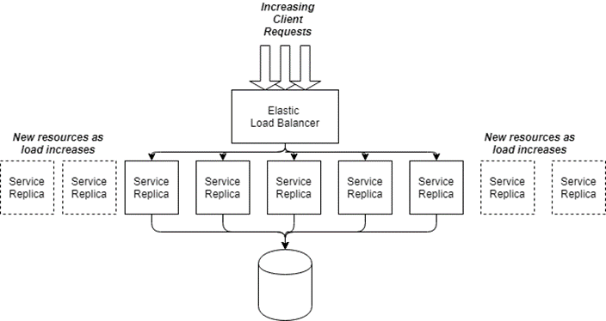
Load Balancers
Load Balancer Features
Elasticity
Two ways to control the number of services in a group.
Schedule-based
dynamic based on thresholds such as CPU usage
Instances need time to startup
not available until after warmup period
When service group average CPU utilization drops below a threshold, scale in or scale down invoked
Notes:
Spikes in request loads can cause the service capacity available to a load balancer to become saturated leading to longer response times and eventually request and connection failures.
Elasticity is the capability of the load balancer to dynamically provision new service capacity to handle an increase in requests.
As load increases new replicas are started and the load balancer directs requests to these
As load decreases the load balancer stops replicas that are no longer needed.

Slide 29
Load Balancers
Load Balancer Features
Session Affinity
Aka sticky sessions
Load balancer sends all requests from the same client to the same service instance.
AWS Elastic Load Balancing generates an HTTP cookie that identifies the service a client’s session is associated with.
Cookie is returned to client, which must send it in subsequent request to ensure session affinity is maintained
Notes:
Session affinity or sticky sessions are a load balancer feature for stateful services.
With sticky sessions the load balancer sends all requests from the same client to the same service instance.
This enables the service to maintain in-memory state about each specific client session.
AWS Elastic Load balancing generates an HTTP cookie that identifies the service replica a client’s session is associated with.
The cookie is returned to the client, which it must send it in subsequent requests to ensure session affinity is maintained.

Slide 30
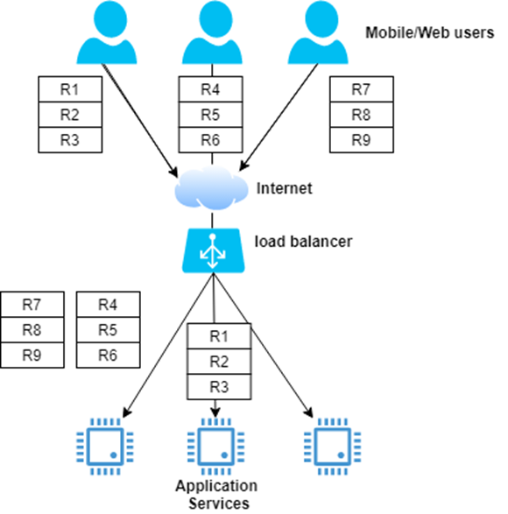
Load Balancers
Load Imbalance (for Sticky Sessions)
Notes:
Sticky sessions can be problematic for highly scalable systems.
They can lead to load imbalance problem in which over time clients are not evenly distributed across services.
Load imbalance occurs if sessions last varying amount of time.
For smaller systems this may not be a problem but for large systems this is inevitable. Some are overwhelmed and may fail due to memory exhaustion.

Slide 31
Stateful versus Stateless
Stateful services have other downsides
How do clients connect when the service fails?
How do clients respond when the service is unresponsive?
Stateless services have none of these downsides.
If service fails, the clients retries and request routed to another live service.
If a service is slow, the load balancer takes it out of the service group until it passes health checks of fails.
Stateless services
enhance scalability
simplify failure scenarios
ease the burden of service management
Notes:
Stateful services have other downsides
When a replica fails how do the clients connect.
How do clients respond when a service or replica becomes unresponsive.
Stateless services do not have these downsides.

Slide 32
Scalable Service Design - Summary
Service API specifies contract with client
Application service containers provide powerful multithreaded execution environments
Performance tuning and monitoring are crucial for optimization
Load balancing with stateless services is a key scalability pattern

Slide 33
Caching
Introduction
Caching is essential in a scalable system
Makes the results of expensive queries and computations available for reuse
Caches exist in many places in an application
This section covers:
Application based caching
HTTP/Web based caching
Notes:
Caching is one of the essential techniques available for building scalable systems.
Caching makes results of expensive queries available for reuse by subsequent requests at low cost.
By reusing the cached results and not reconstruct the results at every request the capacity of the system is increased.
Caches exist in many place in an application.
CPUs have caches to reduce queries to main memory
Database engines have caches so that queries do not query disks for similar queries.
There are 2 main flavors of caching we will talk about.
Application caching – requires business logic that incorporates the caching and access of precomputed results using distributed caching.
Web based caching – Exploits mechanisms built into the HTTP protocol to enable caching of results within the infrastructure provided by the internet. When used effectively both will protect your services and databases from heavy read traffic loads.
Generally a browser based cache controlled by request and response headers

Slide 34
Application Caching
Improve request responsiveness by storing the results of queries and computations in memory
Newspaper articles
Concert seating map
Hourly weather forecast
Caching relieves databases of heavy read traffic
Caching requires additional resources/cost to store cached results.
3% of infrastructure at Twitter is dedicated to application level caches
Notes:
Application caching improves request responsiveness by storing the results of queries and computations in memory so they can be served by later requests.
Example – newspaper article where readers can leave comments. Once posted articles change infrequently.
Hence, an article can be cached on first access and reused by all subsequent requests until the article is updated or no one wants to read it anymore.
In general, caching relieves databases of heavy read traffic.
It also reduces the computation cos for objects that are expensive to construct. For example objects that need queries accessing several different databases.
Caching requires additional resources hence cost. However well designed caching schemes are low cost compared to upgrading database and service nodes to cope with higher request loads.
As an indication of the value 3% of Twitter infrastructure is dedicated to application level caches. At Twitter scale operating hundreds of clusters that is a lot of infrastructure.

Slide 35
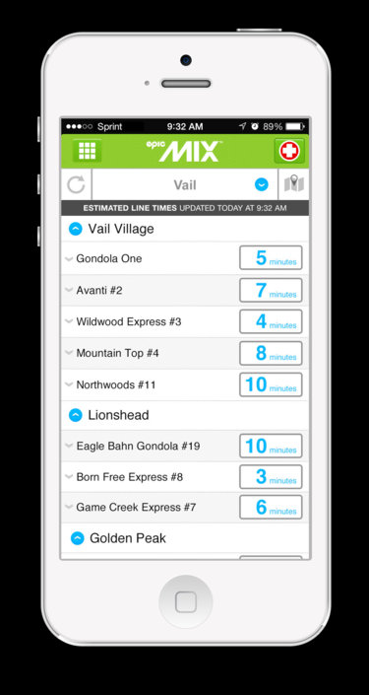
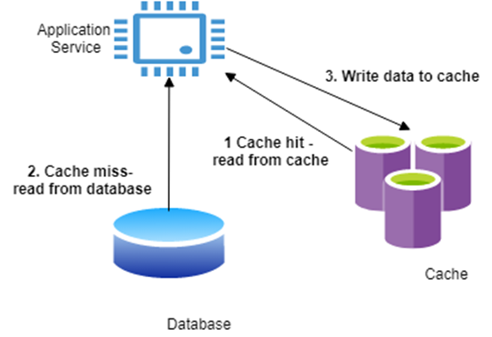
Application Caching
Utilize cache engines, e.g.:
Redis
Memcached
Distributed in-memory key-value stores
Objects allocated to individual cache servers using hashing on object key
Notes:
Application level caching expoits dedicated distributed cache engines.
The two main technologies in this area are Redis and Memcached.
Both are distributed in memory hash tables designed for arbitrary data (strings, objects) representing the results of database queries or downstream service API calls.
Example
Every time a skier loads a lift, a message is sent to the company’s service that collects data about skier traffic patterns. Using this data, the system can estimate lift wait times from the number of skiers who ride a lift and the rate they are arriving. This is an expensive calculation, taking maybe a second or more at busy times,
For this reason, once the results are calculated, they are deemed valid for five minutes. Only after this time has elapsed is a new calculation performed and results produced.

Slide 36
Caching Example
public class LiftWaitService {
public List getLiftWaits(String resort) {
List liftWaitTimes = cache.get(“liftwaittimes:” + resort);
if (liftWaitTimes == null) {
liftWaitTimes = skiCo.getLiftWaitTimes(resort);
// add result to cache, expire in 300 seconds
cache.put("liftwaittimes:" + resort, liftWaitTimes, 300);
}
return liftWaitTimes;
}
}

Slide 37
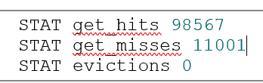
Application Caching
Satisfy as many requests as possible from the cache - hit rate.
maximize the hit rate and miss rate
If items updated regularly, cost of cache misses negate benefits of the cache.
Monitor the cache usage for the service
Notes:
When the cache is valid, all requests will utilize it.
A cache hit on a fast network will take may be a millisecond – much faster than the lift wait times calculation.
Therefore, if we get N requests in a 5-minute period N -1 requests are served from the cache. Imagine if N is 10000.

Slide 38
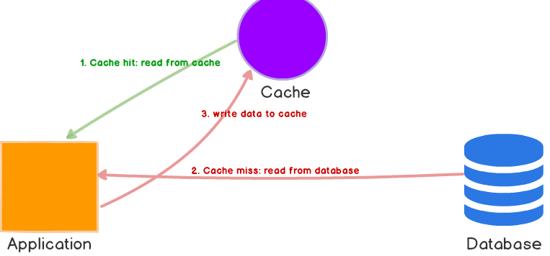
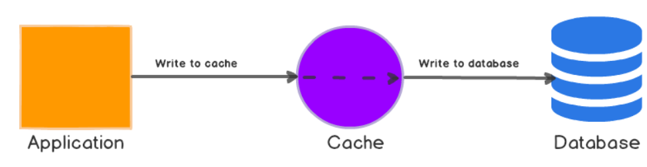
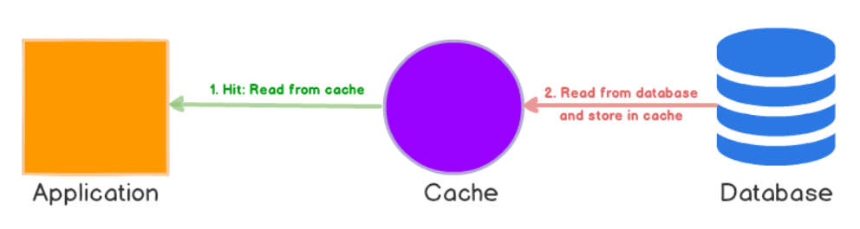
Caching Patterns
Application level caching known as cache-aside pattern – Application bypasses the database if the results are in the cache.
Alternatives exist, commonly supported by databases
Read-through
Write-through
Write-behind
Cache Aside Caching
Write Through Caching
Read Through Caching
Notes:
Read- through. The application satisfies all requests by accessing the cache. If the data required is not available in the cache, a loader is invoked to access the database and load the results in the cache for the application to utilize.
Write- through- The application always writes updates to the cache. When the cache is updated, a writer is invoked to write the new cache values to the database. When the database is updated, the application can complete the request.
Write- behind: Like write-through, except the application does not wait for the value to be written to the database from the cache. This increases request responsiveness at the expense of possible lost updates if the cache server crashes before a database update is completed. This is also known as a write-back cache, and internally is the strategy used by most database engines.

Slide 39
Analysis of Caching Patterns
Read/write-through/behind simplify application logic as service always accesses cache contrast to Application cache as it needs to be aware of cache misses.
Require a cache augmented with an application-specific handler to performs database reads and writes, e.g:
NCache
Amazon’s DynamoDB Accelerator (DAX)
Cache aside:
More complex programming model
Resilient to cache failure
Super scalable
Notes:
The beauty of these caching approaches is that they simplify application logic.
The applications always utilize the cache for reads and writes and the cache provides the magic to ensure the cache interacts appropriately with the backend storage systems.
This contrasts with the cache-aside pattern in which the application logic must be cognizant of the cache misses.
AWS DynamoDB Accelerator sits between application code and DynamoDB.
One significant advantage of the cache-aside strategy is that it is resilient to cache failure. In an event of cache failure all requests are essentially handled as a cache miss.
In addition scaling cache aside platforms such as Redis and Memcached is straightforward due to their simple distributed hash table model. Hence, cache-aside is the primary approach seen in massively scalable systems.
Application specific handler require it be exact as the data model

Slide 40
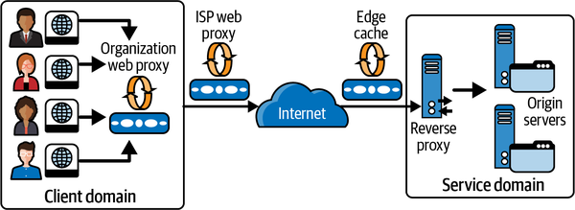
Web Caching
Notes:
One of the reasons that websites are so highly responsive is that the Internet has web caches at different places.
Web caches store a copy of a given resource. E.g. a web page or an image for a defined time period.
The caches intercept client requests and if they have requested a resource caches locally they return the copy rather than forwarding the request to the target service.
These caches are also physically closer to the client and hence the requests will have lower latencies.
Multiple levels of caches exist
Starting with the client’s web browser cache and local organization-based caches.
ISPs will also implement general web proxy caches
Reverse proxy caches can be deployed within the application services execution domain.
Web browser caches are known as private caches (single user)
Organizational and ISP proxy caches are shared caches.
Edge caches, also known as content delivery networks (CDNs), live at various strategic geographical locations globally, so that they cache frequently accessed data close to clients. For example, a video streaming provider may configure an edge cache in Sydney, Australia to serve video content to Australian users rather than streaming content across the Pacific Ocean from US-based origin servers. Edge caches are deployed globally by CDN providers. For media-rich sites with global users, edge caches are essential.

Slide 41
Cache Control
1. Response:
2. HTTP/1.1 200 OK Content-Length: 9842
3. Content-Type: application/json
4. Cache-Control: public
5. Date: Fri, 26 Mar 2019 09:33:49 GMT
6. Expires: Fri, 26 Mar 2019 09:38:49 GMT
Notes:
Caches typically store the results of GET requests only and the cache key is the URI of the associated GET.
When a client sends a GET request, it may be intercepted by one or more caches along the request path.
Any cache with a fresh copy can return a response.
If no cached content is found, the request is served by the service endpoint i.e. the origin server.
Services can control which results are cached and for how long they are stored by using HTTP caching directives. Services set these directives in various HTTP response headers.

Slide 42
Cache Directives
no-store: a resource from a request response should not be cached.
no-cache: a cached resource must be revalidated with an origin server before use.
private: a resource only be cached by a user-specific device such as a Web browser
public: a resource can be cached by any proxy server
max-age: defines the length of time in seconds a cached copy of a resource should be retained.
Notes:
The Cache-Control HTTP header can be used by client requests and service responses to specify how the caching should be utilized for the resources of interest. Possible values are:

Slide 43
Expires and Last-Modified
Used if max-age not specified
specify how long resources in cache should remain valid, or fresh.
Once this period expires, it becomes stale and a candidate for eviction.
Expires header is next used to calculate the freshness period.
Finally the Last-Modified header can specify the freshness lifetime based on a heuristic calculation ((date header – last modifies) * 10%)
Request: GET /skico.com/liftlines/Blackstone Response: HTTP/1.1 200 OK Content-Length: ... Content-Type: application/json Cache-Control: public Date: Fri, 26 Mar 2019 09:33:49 GMT Expires: Fri, 26 Mar 2019 09:38:49 GMT <!-- Content omitted -->
Notes:
The Expires and Last-modified HTTP headers interact with the max-age derective to control how long cached data is retained.
Freshness is calculated using a combination of header values. The "Cache-Control: max-age=N" header is the primary directive, and this value specifies the freshness period in seconds.
If max-age is not specified, the Expires header is checked next. If this header exists, then it is used to calculate the freshness period. The Expires header specifies an explicit date and time after which the resource should be considered stale.
As a last resort, the Last-Modified header can be used to calculate resource retention periods. This header is set by the origin server to specify when a resource was last updated, and uses the same format as the Expires header. A cache server can use Last-Modified to determine the freshness lifetime of a resource based on a heuristic calculation that the cache supports.

Slide 44
Etag
Another mechanism to specify cache freshness.
Opaque value that van be used by a cache to check if a cached resource is still valid, eg:
Request:
GET /skico.com/weather/Blackstone
Response:
HTTP/1.1 200 OK Content-Length: ...
Content-Type: application/json
Date: Fri, 26 Mar 2019 09:33:49 GMT
Cache-Control: public, max-age=3600
ETag: “blackstone-weather-03/26/19-v1"
Notes:
HTTP provides another directive that can be used to control cache item freshness. This is known as an Etag.
When a request arrives for the weather report, the service responds with a maximum age to define cache freshness, and also an Etag that represents the version of the weather report that was last issued.
This is shown in the following HTTP example, which tells a cache to treat the weather report resource as fresh for at least 3,600 seconds, or 60 minutes.
The Etag value, namely "blackstone-weather-03/26/19-v1", is simply generated using a label that the service defines for this particular resource. In this example, the Etag represents the first version of the report for the Blackstone Resort on March 26th, 2019. Other common strategies are to generate the Etag using a hash algorithm such as MD5:

Slide 45
Etag – Cache Revalidation
1. Request:
GET /upic.com/weather/Blackstone
If-None-Match: " blackstone-weather-03/26/19-v1“
4. Response:
5. HTTP/1.1 304 Not Modified
Notes:
For the next hour the web cache simply serves this cached report to all clients who issue a GET request based on the max-age value.
After an hour though the resource becomes stale the cache forwards the request to the origin server with a If-None-Match directive along with the Etag to inquire if the resource in our case the weather report is still valid. This is also known as revalidation.
There are two possible responses to this request:
If the Etag in the request matches the value associated with the resource in the service, the cached value is still valid. The origin server can therefore return a 304 (Not Modified) response, as shown in the following example. No response body is needed as the cached value is still current, thus saving bandwidth, especially for large resources. The response may also include new cache directives to update the freshness of the cached resource.
The origin server may ignore the revalidation request and respond with a 200 OK response code, a response body and Etag representing the latest version of the weather report:

Slide 46
Implementing Etags
Generate new daily report:
stored in a database
Stored in cache {#resortname-weather, etag value}
GET requests:
return the weather report and the Etag.
Conditional GET requests:
Lookup the Etag value in cache and return 304 if value unchanged.
If the cached Etag has changed, return 200 along with the latest weather report and a new Etag value.
Update weather report:
A new version of the weather report is stored in the database
Etag value is modified to represent this new version of the response

Slide 47
Summary
Web caching can significantly reduce latencies and save network bandwidth.
Reduces the request load on origin servers, creating additional capacity
Web Proxy caches such are extensively deployed in the Internet

Slide 48
Questions?

